Slide 1
Objectives
Be able to specify the uses and effects of the Python operators and to use them in natural ways, taking into account their precedences
Be able to describe what is meant by a keyed collection and to say what data structures in Python are keyed collections
Be able to specify the uses and effects of the built-in Python data structures (collections) and to use them in natural ways
Be able to use Python subscripting and slicing
Be able to take advantage of Python tuple assignment
Be able to classify Python data types as mutable or immutable, and to demonstrate what is meant by those terms

Slide 2
Some Object-Oriented Terminology
C++/Python camp:
Member functions are called to invoke behaviors of objects
Smalltalk / Objective C / Swift camp:
Methods are used to send messages to objects, again invoking behaviors

Slide 3
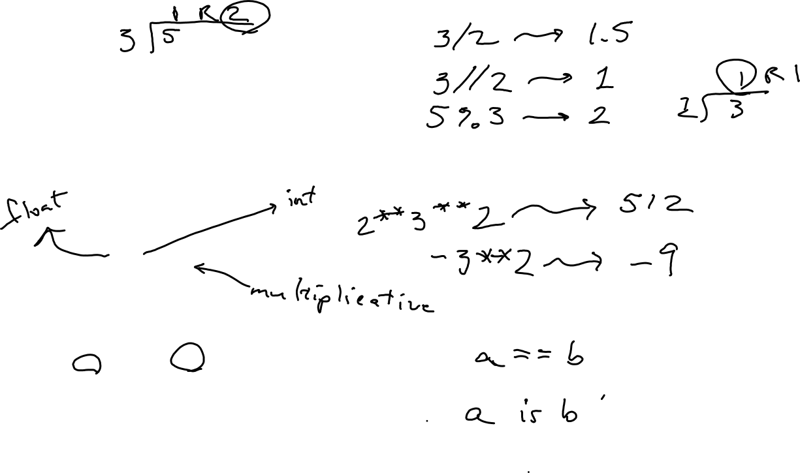
Operator Precedence
The following list is in order from most tightly to least tightly binding. Function call precedence is not listed, but can safely be considered the same as [] (slicing and subscripting):
.
[] (slicing, subscripting)
** (right to left)
Unary +, -, ~ (bit-level “not”)
*, /, //, %
+, -
<<, >> (shifts)
& (bit-level “and”)
^ (bit-level “exclusive or”)
| (bit-level “or”)
is, is not, ==, !=, <, >, <=, >=
not
and
or

Slide 4
Python collections
All Python collections are heterogeneous (NOT required to be all same type) except str, byte, and bytearray

Slide 5
Keyed Collections
set and dict are keyed, not subscripted in the ordinary sense…

Slide 6
Length function
All built-in data collections in Python support the len function

Slide 7
All non-keyed Python data structures support
Subscripting
Slices
Notes:
Use strings to illustrate

Slide 8
Lists
Lists (type list) are mutable, variable-sized, sequential, heterogeneous collections
List construction syntax is provided by the language, and consists of a comma-separated list of expressions delimited by square brackets.
Example: [89, 3.45,'ham',[7,8]]
Can grow the list from the rear with the append() message, and remove items with the pop() message or the Python del primitive.

Slide 9
More about Lists
Lists are mutable:
>>> a = [21, 7j, 'Abe']
>>> a[1] += 1
>>> a.append('Mary')
>>> a
[21, (1+7j), 'Abe', 'Mary']
Slices can receive values:
>>> a[0:2] = ["Robert"]
>>> a
['Robert', 'Abe', 'Mary']

Slide 10
Some other member functions of class list
append
pop
sort
reverse
index
count
remove

Slide 11
str is immutable
Can delimit a string literal with single, double, or triple quotes
Example:
mandy = 'Mindy'
mandy[1] = 'a' #Illegal. Can’t change a string.
Instead, do…
mandy = mandy[0]+'a'+mandy[2:]
There is no “single-character” type. Python uses a one-character string instead. If s is a one-character string, then ord(s) is the character code of that one character.
If m is a small positive integer, then chr(m) is a one-character string whose only element has character code m.

Slide 12
Type bytes
Objects of type str are strings of 16-bit characters.
Objects of type bytes are strings of 8-bit characters.
Like str, bytes is homogeneous and immutable.
A bytes literal is like a string literal, but prefixed with the character b.
The characters in b'Chicken' occupy seven bytes.
The characters in 'Chicken' occupy fourteen bytes.

Slide 13

Type bytearray
Closely related to bytes is the other mutable sequence, bytearray.
This type has no literals, but a bytes object can be used to construct a bytearray object, as follows…

Slide 14
Input and Output

Slide 15
Type tuple
tuple is an immutable, heterogeneous sequence type.
A comma-separated list of expressions, enclosed in parentheses, is a tuple-valued expression
Note that although a tuple is immutable, if one of its elements is mutable that element can be sent value-changing messages.
It is the identity of the object that cannot be changed

Slide 16

More tuple particulars
When there is no danger of ambiguity, the parentheses enclosing a tuple expression can be omitted.

Slide 17
Tuple assignment
Tuple assignment allows the individual elements of a sequence to be assigned to corresponding variables on the left-hand-side of the assignment operator.
Examples:
(dad, mom) = ("George", "Martha")
(pi, e) = 3.14159, 2.71828
vegetable, meat, drink, dessert = \
[ 'carrots', 'steak', 'tea', 'pie' ]

Slide 18
Returning a tuple from a function
This interpretation of assignment provides an interesting way for a function to return more than one value. As an example, consider the following function.
def divide(dividend, divisor):
return dividend//divisor, dividend%divisor
This function returns a two-element tuple and could be called as follows.
quo, rem = divide(25, 7)

Slide 19
More String Operations
The % operator relies on format codes similar to those used in the C language printf() library function.
A similar (seemingly redundant at first glance) facility also present in Python employs ordinal numbers in curly braces and a format() message.
labeling = \
"{0} cares nothing for {1}; she only cares for {0}."
print(labeling.format("Emma", "Paul"))

Slide 20
Keys
Among built-in types, only immutable types can be keys for a set or dict.
This is because changing an object’s value once it has been placed in one of these keyed data structures can make that object unreachable
Programmer-defined types may violate this principle, because Python does not attempt to check new types to ensure they are immutable – that is the programmer’s responsibility

Slide 21
Type set
The following code creates a keys-only collection called a set and places three values in it.
s = set()
s.add(39)
s.add('Lois')
s.add(5+1j)
Or we could do the same thing using a set-valued expression, as follows:
s = {39, 'Lois', 5+1j}

Slide 22
Type dict
Objects of type dict store (key, value) pairs.
The following code creates a dict object.
b = dict()
b['Ralph'] = 1949
b['Jen'] = 1980
Equivalent is…
b = {'Ralph':1949, 'Jen':1980}
Or…
b = dict(Ralph=1949, Jen=1980)

Slide 23
Control Structures – if, if…else, and if…elif…else

Slide 24
Control Structures - while

Slide 25
Exception Handling

Slide 26
Defining functions

Slide 27
Defining classes

Slide 28
Scopes – block scope, class scope, and object scope

